Slide 1
Java 4 WEB
Lesson 17 - Home Task Overview

Slide 2
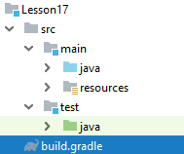
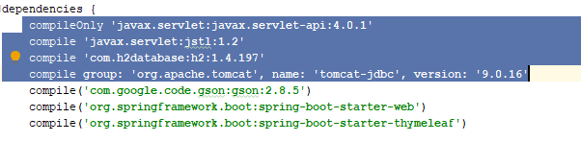
1. Do not copy-paste useless code
Notes:
This libs are not used anymore or supplied with spring boot dependency

Slide 3
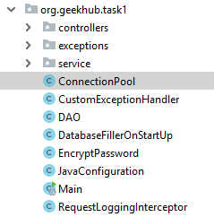
2. What is the lesson number?
Notes:
Do not violate project structure convention
Do not put all code into one package

Slide 4
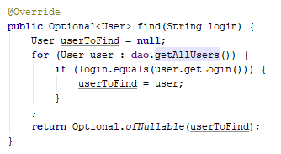
3. Do not extract all data when one needed

Slide 5
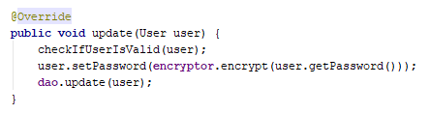
4. User should be able to login after update

Slide 6
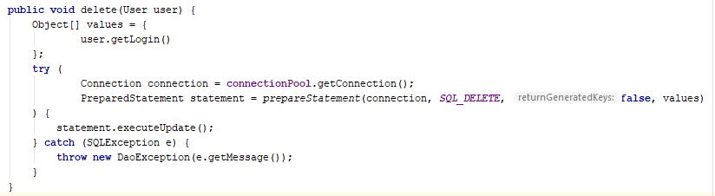
5. Use profit from Connection Pool usage
Notes:
Do not close connections on every usage. It is a job of connection pool

Slide 7
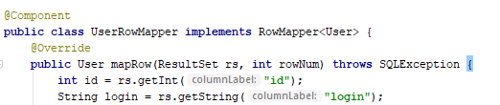
6. Do not register everything as bean

Slide 8
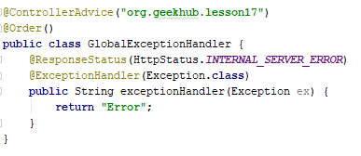
7. Advice should give some profit

Slide 9
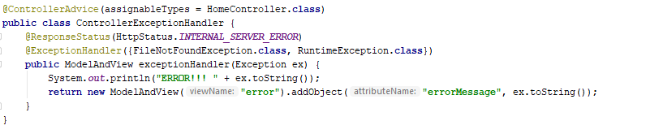
8. Logger should be used for logs

Slide 10
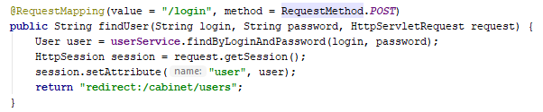
9. Store only needed info in session

Slide 11
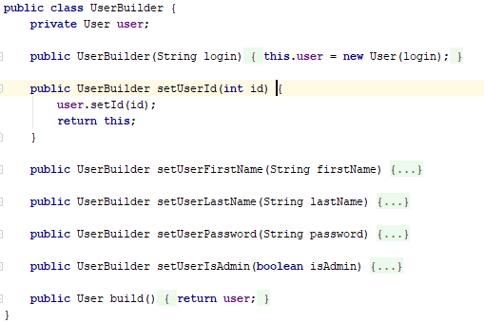
10. Do return a new object on every build

